Slide 1



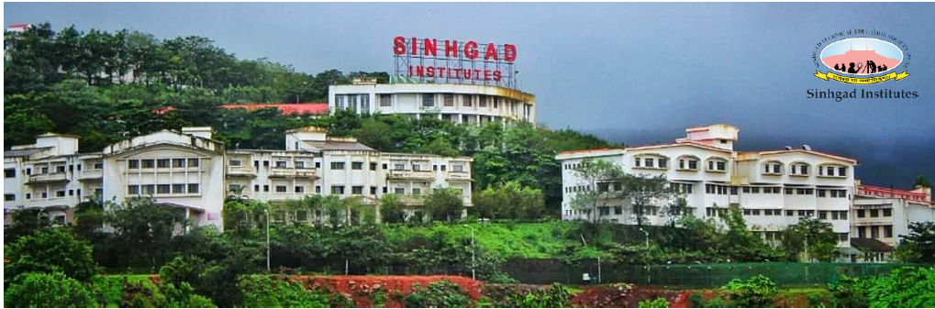
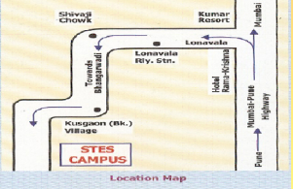


ABOUT STES:
Sinhgad Technical Education Society (STES) was set up in August 1993, under the able and dynamic leadership of Prof. M. N. Navale with an objective of providing quality education in the field of Engineering, Dentistry, Management, Computer, Pharmacy, Architecture, Hotel Management and the basic school education from kinder garden onwards. There are 58 institutes under the aegis of STES offering full-fledged school education, diploma, Graduation, Post Graduation courses and Ph.D. programs in various branches of Engineering, Science and Management at five educational campuses ideally located in pollution free lush green and picturesque environment conducive for learning. (sit.sinhgad.edu)
Emerging technologies are characterized by radical novelty relatively fast growth, coherence, prominent impact, and uncertainty and ambiguity.
Learning technologies open up significant possibilities for supporting learners. Researchers in the field use the term affordances to refer to opportunities that a technology makes possible related to learning and instruction. It gives us immense pleasure that TechnicoKnockdown-23 is National level conference organized by IEEE student Branch of SIT, Lonavala for providing a common platform to everyone to explore their knowledge
..
National Level Students Conference
TECHNlCOKNOCKDOWN-23
May 05, 2023
ORGANIZED BY
IEEE and IETE STUDENT BRANCH, SIT LONAVALA, 410401
Technically Sponsored by
IEEE Bombay Section
NAME OF THE TRACKS:
Internet of Things (IoT)
Artificial Intelligence and Machine Learning
Cyber Security
Communication Network
Media and Signal Processing
Green ICT
Advanced Smart Grids and Power Systems
Robotics and Automation
Original and unpublished technical papers are invited. The paper should be strictly in IEEE format. The paper should reach the convener on or before April 12, 2023, through registration link
ABOUT SIT:
Sinhgad Institute of Technology (SIT), Lonavala since its establishment in 2004 is involved in practicing teaching-learning methodologies of excellence to deliver quality engineering education for students all over India. The institute is housed in beautiful surroundings, fully residential campus of 200 acres on Pune-Mumbai expressway at Lonavala. Academic discipline with space for individual innovations, emphasis on life skill development of students, ‘willing to work’ team of faculty members and initiative for Industry interface, have been the silent activity of the college Institute has following branches
E&TC, Engineering
Mechanical Engineering
Electrical Engineering
Computer Engineering
Information Technology
HOSTED 8Y
. Department of E&TC
SINHGAD INSTITUTE OF TECHNOLOGY, LONAVALA
How to reach Sinhgad Institute of Technology
Link for Registration: https://forms.gle/skKMbd2wZyiCXYmMA
OBJECTIVE:
To provide an opportunity for participants to upgrade their Knowledge in new emerging areas of technology.
To provide platform for interaction of professionals, researchers, UG and PG students from different universities, Industries, Research Organization and academia
Technically Sponsored by IEEE Bombay Section and IETE Pune Center

Slide 2


Chief Patrons
Hon Prof. M. N. Navale
Founder President, STE Society, Pune
Hon Dr. (Mrs) S. M. Navale
Founder Secretary, STE Society, Pune
Hon Ms. Rachana Navale Ashtekar
Vice-President (Admin), STE Society, Pune
Hon Rohit M. Navale
Vice President (HR), STE Society, Pune
Organizing Chairman
Dr. M.S. Gaikwad
Director, STES Campus, Lonavala
Principal, Sinhgad Institute of Technology, Lonavala
Dr. D.D. Chaudhary
Vice-Principal & HOD, Dept. of E&TC, SIT, Lonavala
Advisory Committee
Anand Ghrapure, Chair, IEEE Bombay Section
Saurabh Mehta , Secretary IEEE Bombay Section
Prof. Kiran Talele, Treasurer, IEEE Bombay Section
Dattatray Sawant ,Chair SAC, IEEE Bombay Section Dr. V. V. Shete, Chairman IETE, Pune Center
Dr. D.G. Bhalke , Secretary, IETE, Pune Section
Dr. V. V. Somani, Treasurer, IETE Pune Section
Mr. S. M. Gaikwad HOD. Mech Dept., SIT, Lonavala
Dr. S. D. Babar HOD, Comp. Dept., SIT, Lonavala
Mr. S. A.Datey HOD, Elect. Dept., SIT, Lonavala
Dr. R.V. Babar, HOD, IT Dept., SIT, Lonavala
Dr. P. S. Patil HOD, FE Dept., SIT, Lonavala
Editorial Committee
Mr. V. M. Chavan, Asst. Prof., Dept. of Comp, SITL
Mr. V. D. Raskar, Dept. of E&TC, SIT, Lonavala
Mr. V. S. Bari, Asst. Prof., Dept. of E&TC, SITL
Mr. Aniket Lamkhade, IEEE SIT SB, Student Chairman
REGISTRATION FORM
National Level Student Conference
TechnicoKnockdown-23(TKD-23)
on
(May 4, 2023)
Theme : Next Generation Networks
Name:
Department:
Institute/ organization:
Correspondence Address:
Mobile No. :
Email ID:
No. of Group Members:
Are you IEEE member: Yes/No :
If Yes, IEEE Member No.:
Are you IETE member: Yes/No :
If Yes, IETE Member No.:
Signature of Participant
Address for Correspondence
Dept. of Electronics & Telecommunication Engg.
Sinhgad Institute of Technology Lonavala,
Pune. 410 401, MS, India.
02114- 673401, 673219,673220.
Website: sit.sinhgad.edu
E-mail: web.sit42@gmail.com
Organizing committee
Dr. S. B. Gholap Mr. P.V. Raut (Comp)
Ms. S.S. Patil Mr. A. P. Kulkarni (IT)
Ms. V.G. Rajeshwarkar Mr. A. K. Desai (Comp)
Mrs. S.K. More Mr. S. N. Datkhile( Elect)
Mr. S.A. Bhad
Mr. M.S. Raut
Ms. C. A. Mhetre
Technical Support
Ms. R. D. Mantri, Dept. of Mech, SIT ,Lonavala
Ms. D. S Mali, Dept. of E&TC, SIT, Lonavala
Ms S. B. Pandit, Dept. of E&TC, SIT, Lonavala
Important Dates
Paper Submission : April 12, 2023
Acceptance Notifications : April 19, 2023
Camera Ready Paper : April 26, 2023
Conference Date : May 04, 2023
Registration Fee
Registration fees : Rs. 250/- Per Group.
Convener
Dr. D. S. Mantri, Professor, Dept. of E&TC, SITL
(+91 9922431612)
Mr. P. R. Dike, Asst. Prof., Dept. of E&TC, SITL (+91 9422014174)
Link For Paper Template
Strictly according to IEEE MS Word format https://www.ieee.org/conferences_events/conferences/publishing/templates.html
Registration Link https://forms.gle/skKMbd2wZyiCXYmMA
WhatsApp: https://chat.whatsapp.com/E9bo63z9QmB8HbKIeKGsuO
Telegrapm:https://t.me/joinchat/RYPc7BkEbUGTwqfFujDaXQ
Co-ordinator
Ms. P. S. Mhetre, Asst. Professor, Dept. of E&TC, SIT, Lonavala [9404249846]
Mr.M.K.Bhosale Asst. Professor, Dept. of E&TC, SIT, Lonavala [7588628575]
Mr. V.S.Bari ,Asst. Professor, Dept. of E&TC, SIT, Lonavala [8600517040]
Important Instructions:
UG, PG students submit the paper
Use IEEE template for paper (A4 Size)
Abstract: 100-200 word
No. of Pages : Double column 4-5 pages
Upload paper using registration link
Paper will be published in IEEE TKD-23 proceeding
E-certificate will have IEEE and IETE Logo
Proceeding will have ISBN No. 978-81-929945-5-0
For Queries Contact
Mr. P. R. Dike (+91 9422014174) Ms. P. S. Mhetre (+91 9404249846)
Mr. Aniket Lamkhade (+91 9130043090)
Ms. Rajeshri More (+91 9022868097)
Ms. Sanskriti Gaikwad (+91 8080976282)
Session Coordinator
Mr. A. A. Labade, Asst. Prof., Dept. of E&TC, SITL
Mr. M.K. Bhosale, Asst. Prof., Dept. of E&TC, SITL

